Slide 1
Vector Embedding
The New Building Blocks for Generative AI
Center for Advanced AI
Lan Guan, Mo Nomeli

Slide 2
The Challenge of Unstructured Content
Data Type | Description | Advantages | Disadvantages
Structured Data | Organized in tables with rows and columns | Easy to search and analyze Clear and well-defined format | Limited in scope and richness Doesn't capture complex relationships
Unstructured Data | No predefined format, like text, images, or audio | Rich in potential insights Captures real-world complexities | Difficult to process and analyze with traditional tools Requires additional steps to unlock value
Structured Data with Easy Operations:
Unstructured Data with Difficult Operations:
Company Name | CEO | Headquarters Location | Number of Employees | Industry
Acme Inc. | Jane Smith | New York City, NY | 5,000 | Technology
Global Corp | Mark Johnson | London, UK | 20,000 | Manufacturing
Green Energy | Sarah Patel | San Francisco, CA | 800 | Sustainability
Innovate | Alex Lee | Berlin, Germany | 3,500 | Software
… | … | … | … | …
...In a surprise announcement today, Acme Inc. revealed a significant strategic shift under the leadership of its newly appointed CEO, Jane Smith. During a press conference, Smith outlined a comprehensive plan focusing on sustainable growth initiatives, a move that signals a departure from the company's previous strategies.
"We believe the future of business lies in responsible innovation," Smith stated. "Acme Inc. is committed to creating long-term value while minimizing our environmental impact."...
Query: Find all companies with more than 1,000 employees.
Filter: Sort CEOs alphabetically.
Calculate: Determine the average company size.
Question: Which other CEOs are pursuing sustainability?
Insight: Is this strategy shift common in the industry?
Prediction: How might this affect Acme Inc.'s stock price?

Slide 3
Measure, Compare, Discover: The Power of Vectors
Capabilities of Vector Operations:
Measure the distance between individual data points.
Determine the similarity between different data points.
Transform data in ways that are useful for analysis.
Similar
Unrelated
Opposite
Near 0 degrees
Near 90 degrees
Near 180 degrees

Slide 4
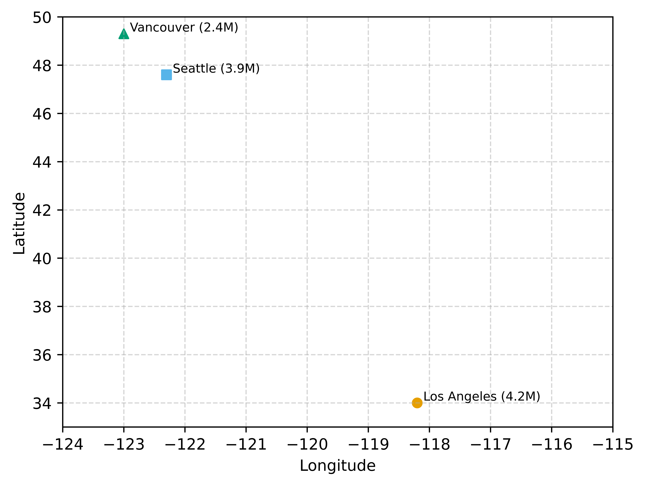
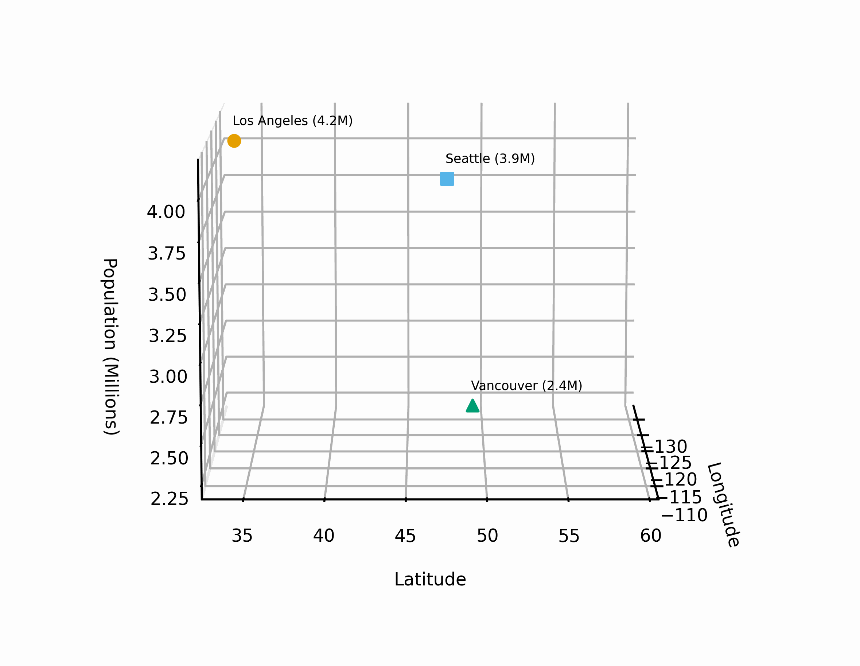
What is a vector embedding?
A vector is a fixed-length array of numbers that represents a point in a mathematical space.
Each number in the array corresponds to a direction (or dimension) within this space, and its value determines the vector's magnitude in that direction.
While vectors in machine learning can have thousands of dimensions (difficult to visualize), simpler vectors with two or three dimensions can be easily graphed and understood.
A vector embedding, or simply "embedding," is a way to turn things that aren't numbers (like words or pictures) into a list of numbers. This list captures the important qualities and relationships within the original data.
Embeddings capture semantic similarity, tone and hierarchical relationships (“MIT” will be close to “University”; ”Happy” will be farther than “Sad”; ”Car” will be close to “Vehicle”)
Different types of data (like audio, text, video, etc.) need different embedding methods or algorithms to do this well.
Types of embedding techniques:
  Frequency-based (TF-IDF)
  Prediction-based (Word2Vec, FastText, GloVe)
City | Longitude | Latitude | Population (Millions)
Los Angeles | -122.4 | 37.8 | 4.2
Seattle | -122.3 | 47.6 | 3.9
Vancouver | -123.1 | 49.3 | 2.4
Key Takeaway: Embeddings work similarly. More dimensions mean capturing more complex nuances and revealing hidden patterns.

Slide 5
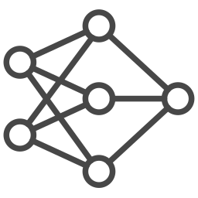
Vector Embeddings: Translating Data for Computers
Computers struggle to directly understand the way humans communicate, like text, pictures, or sounds. To help, we can turn these formats into numerical representations called 'vectors' that computers can process more easily.
0.42 | -0.17 | 0.35 | 0.82 | 0.74 | 0.42 | -0.17 | 0.35 | 0.82 | 0.74
0.42 | -0.17 | 0.35 | 0.82 | 0.74 | 0.42 | -0.17 | 0.35 | 0.82 | 0.74
0.42 | -0.17 | 0.35 | 0.82 | 0.74 | 0.42 | -0.17 | 0.35 | 0.82 | 0.74
Audio
Audio Model
Audio Vector Embeddings
0.42 | -0.17 | 0.35 | 0.82 | 0.74 | 0.42 | -0.17 | 0.35 | 0.82 | 0.74
0.42 | -0.17 | 0.35 | 0.82 | 0.74 | 0.42 | -0.17 | 0.35 | 0.82 | 0.74
0.77 | 0.18 | 0.65 | 0.72 | 0.73 | 0.37 | -0.11 | 0.65 | 0.72 | 0.73
Text
Text Model
Text Vector Embeddings
0.42 | -0.17 | 0.35 | 0.82 | 0.74 | 0.42 | -0.17 | 0.35 | 0.82 | 0.74
0.42 | -0.17 | 0.35 | 0.82 | 0.74 | 0.42 | -0.17 | 0.35 | 0.82 | 0.74
0.07 | 0.12 | 0.45 | 0.84 | 0.76 | 0.27 | 0.93 | 0.45 | 0.81 | 0.76
Video
Video Model
Video Vector Embeddings

Slide 6
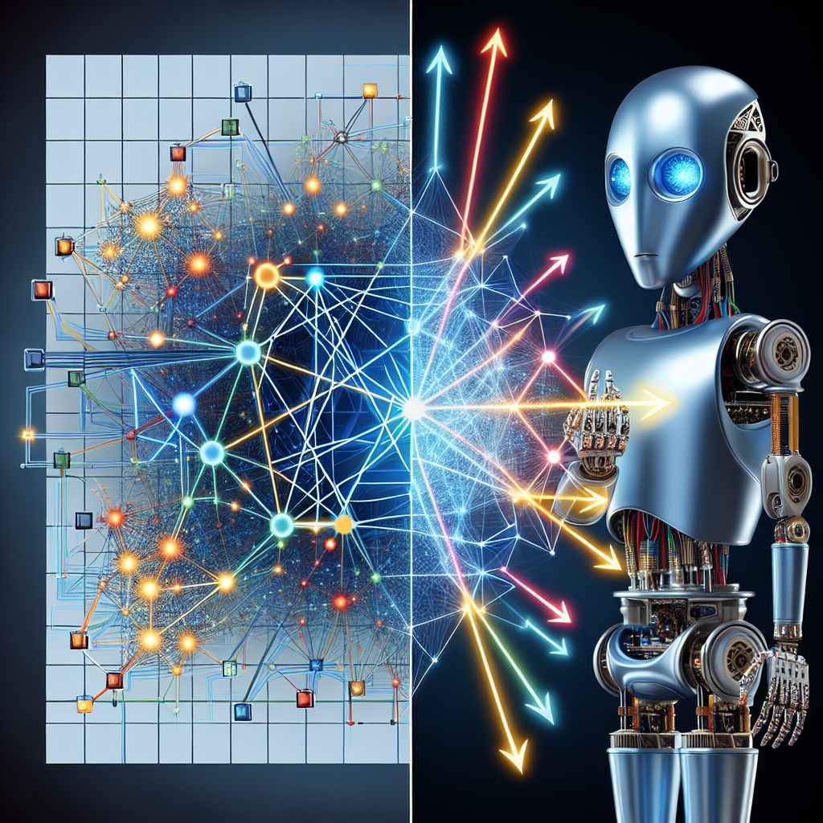
Data has a secret code: Embeddings Explained
Text embeddings understand how words are related. They can tell that words like "king" and "queen" are similar, but that "king" and "car" are very different.
Image embeddings turn pictures into a special code that remembers what the picture looks like. This code focuses on things like colors, shapes, and how smooth or bumpy something is. For example, the code for an orange would be closer to the code for a yellow object than a black one, because they share similar colors.
Audio embeddings turn sounds into a kind of code. This code remembers what the sound is like – is it high or low, what instrument makes it, etc. For example, a piano and a guitar would have different codes because they sound very different, even if they play the same note.
Temporal embeddings track changes over time. For example, they can record how your heart rate goes up and down when you rest, sleep, or run. This helps compare heart rates for different activities and spot unusual patterns.

Slide 7
Vector Embeddings: Preserving Context in NLP
Text Representation Challenge: Computers “think in numbers,” so we need to convert natural language into machine-understandable formats.
Traditional Approaches: N-grams (word sequences) and bag-of-words representations.
Evolution: Enter vector embeddings, which capture meaning and context.
Aspect | N-grams | Vector Embeddings
Definition | Contiguous sequences of n words (e.g., unigrams, bigrams, trigrams) | Dense, continuous vector representations for words or sentences
Representation | Based on word frequencies within n-grams | Captures meaning and context
Limitations | Sparse (high-dimensional vectors with many zeros) Context-agnostic Ignores word order | Context-aware Encodes meaning and context
Recent Advances | N-grams with Feature Engineering | Contextualized Embeddings Transformer-Based Architectures Knowledge Graph Integration Multilingual and Cross-Lingual Embeddings Bias Mitigation Embeddings for Specialized Domains
Example | N-grams | Vector Embeddings
"I love my new Apple laptop. It's fast and the design is sleek." | Unigrams only consider individual occurrences like "apple," "laptop," "fast," etc., missing the contextual nuances of what "apple" refers to. | A vector for "Apple" (technology) close to words like "computer", "innovation", "design".
"This apple was mushy and disappointing.” | Bigrams capture some context: "apple laptop", "new apple" vs. "mushy apple”, but may still might struggle if other fruit-related words are common in reviews. | A vector for "apple" (fruit) close to "sweet", "ripe", "tree".)

Slide 8
What can you do with vector embeddings?
Finding Similar Things (Semantic Search): Embeddings help find similar words, documents, or even products. For example, they can find news articles about the same topic. For example “healthy breakfast options” will retrieve content like “nutritious meals”
Organizing Data: Embeddings group similar things together and help label them. This teaches computers how to sort items automatically. For example, in a Customer Service use case, embeddings can help categorize and retrieve similar customer inquiries, pain points leading to faster resolution
Better Search Engines: Embeddings make search engines smarter. They can find what you're looking for even if you don't use the exact same words.
Smart Recommendations: Websites use embeddings to suggest things you might like. If you watch a certain kind of movie, they'll suggest similar ones.
Seeing the Big Picture: Embeddings can be turned into pictures to see how different pieces of data are related.
Faster Learning: Embeddings let computers use what they've already learned for new tasks, so they learn faster.

Slide 9
Vector embeddings with vector databases
How to store and take advantage of vector embeddings?
Vector Database (DB): Vector DBs are purposely built for storing, indexing, and searching across massive datasets of unstructured data through vector embeddings.
How vector databases work?
Approximate Nearest Neighbor (ANN): Vector databases rely on the ANN algorithm to find the closest, most relevant matches to a query.
Spatial Distance: Vectors are compared based on how close they are to each other in a multi-dimensional space. Closer vectors mean higher similarity.
Top 'k' Results: The database returns the 'k' number of closest vectors, allowing the user or LLM to see the most relevant results.
What are the popular use cases for vector databases?
LLM Retrieval Augmented Generation (RAG): Powering advanced chatbots and generative AI systems that need to access and process vast amounts of information. Embeddings help retrieve the most relevant vectors (top K) to ground LLM responses in accurate contextually rich data.
Question and Answer Systems: Enabling accurate and relevant responses to user questions.
Recommender Systems: Tailoring suggestions (products, content, etc.) based on user preferences and similarity analysis.
Semantic Search: Providing search results based on the meaning and context of the query, not just keywords.
Image, Video, and Audio Search: Finding similar media based on visual or audio characteristics.

Slide 10
Vector Database vs. Traditional Database
Feature | Vector Database | Traditional Database
Data Structure | Optimized for high-dimensional vectors | Tables with rows and columns
Storage | Arrays of numbers | Structured format based on schema
Indexing | Approximate Nearest Neighbor for similarity search | Exact keyword matches
Focus | Fast retrieval based on similarity | Structured data retrieval and manipulation
Notes:
Vector Databases:
Structure: Optimized for storing and managing high-dimensional vectors. Each data point is represented by a single vector.
Storage: Vectors are typically stored as arrays of numbers in a flat or hierarchical structure.
Indexing: Utilize specialized indexing techniques like Approximate Nearest Neighbor (ANN) to efficiently find similar vectors based on distance metrics.
Focus: Designed for fast retrieval based on similarity searches, not exact keyword matches.
Traditional Databases:
Structure: Organized in tables with rows and columns. Each row represents a data record, and each column represents a specific attribute.
Storage: Data is stored in a structured format according to the defined schema. Text data might be stored as strings.
Indexing: Use indexing techniques like B-Trees to efficiently search for specific data points based on exact matches in columns.
Focus: Designed for storing and retrieving data based on predefined schema and queries.

Slide 11
LLM Retrieval Augmented Generation (RAG)
Response
Pre-training
Response
Query
Gigantic Dataset
(text, audio, image, video, etc.)
Base/Fine-Tuned LLM
Q/A System
User
Search
Query +
relevant docs
Org/Domain-Specific Vector Database with Embeddings

Slide 12
Key Future Trends in Embedding
Cross-modal embeddings to handle text, image, audio together
Integration w/ quantum computing to accelerate similarity search
Ethical AI to reduce bias
Continuous learning to adapt to new data dynamically
Explainable Embeddings to understand relationships
Integrating with AI Agents
Unsupervised Learning enhancements using embeddings
Ensemble RAG

Slide 13
Group Activity: Embedding Vectors
Word List: [sciences, weather, institute, college, school, university, climate]
Arrange these words in two clusters (education and weather)”

Slide 14
Group Activity: Embedding Vectors
Word List: [sciences, weather, institute, college, school, university, climate]
Arrange these words in two clusters (education and weather):
sciences: [0.7, 0.5, 0.3]
weather: [0.2, 0.7, 0.5]
institute: [0.75, 0.4, 0.25]
college: [0.65, 0.35, 0.4]
school: [0.6, 0.3, 0.45]
university: [0.7, 0.45, 0.35]
climate: [0.15, 0.65, 0.55]

Slide 15
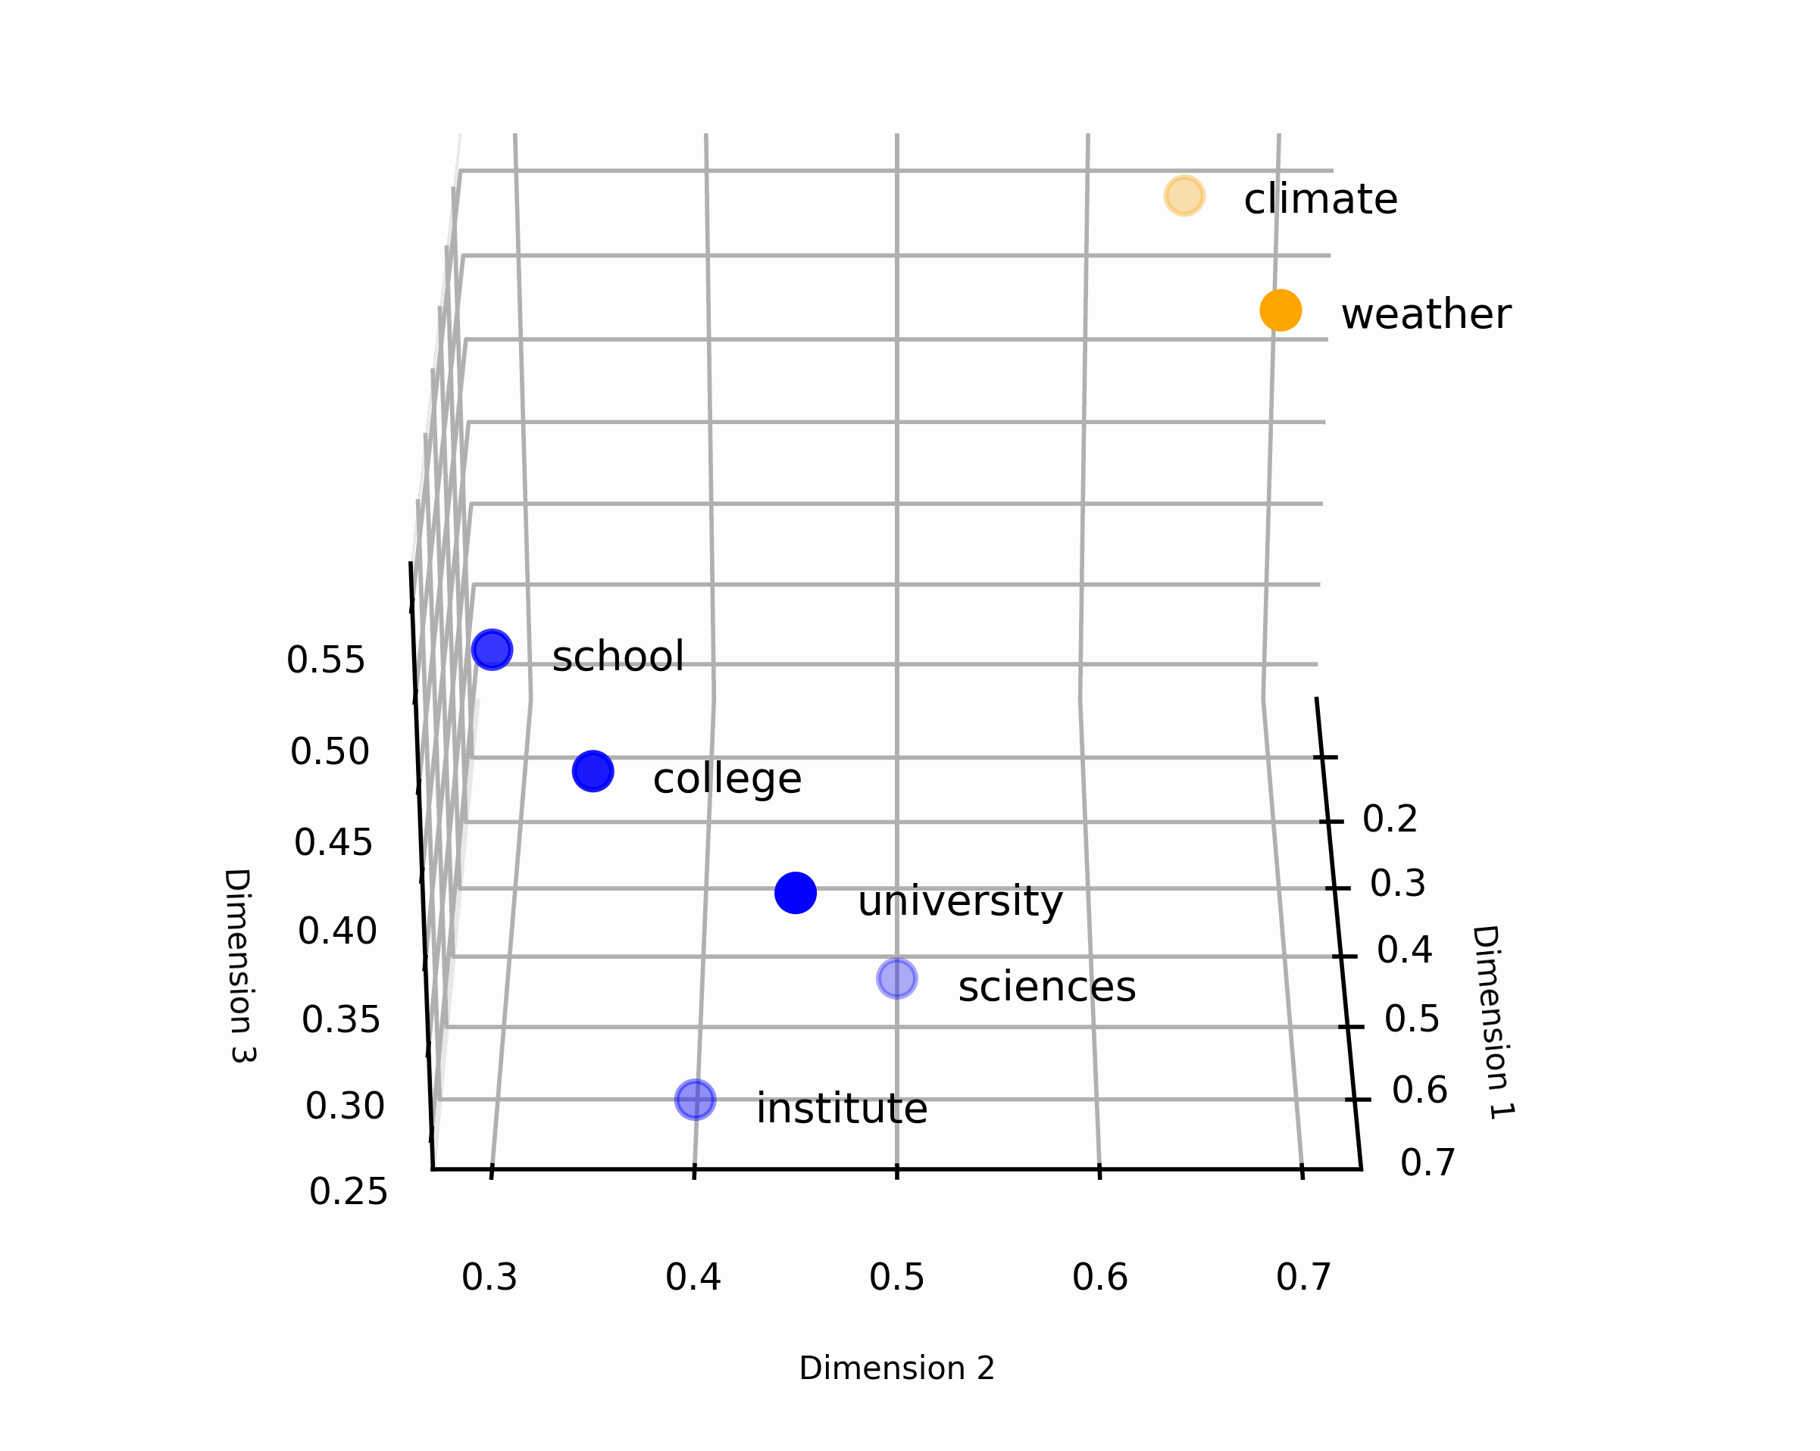
Group Activity: Embedding Vectors
Word List: [sciences, weather, institute, college, school, university, climate]
Arrange these words in two clusters (education and weather), according to how they are used in describing market sentiment.
Solution Discussion
The embedding analysis reveals that words related to education share similar numerical representations, forming a distinct cluster, and the same applies to weather-related terms.
Education Cluster
sciences: [0.7, 0.5, 0.3]
institute: [0.75, 0.4, 0.25]
college: [0.65, 0.35, 0.4]
school: [0.6, 0.3, 0.45]
university: [0.7, 0.45, 0.35]
Weather Cluster
weather: [0.2, 0.7, 0.5]
climate: [0.15, 0.65, 0.55]
Key Takeaway: Embeddings capture these nuances of meaning, which can be far more powerful than simple keyword analysis.

Slide 16
Key Takeaways
Bridging the Gap: Vector embeddings translate various types of data (words, images, etc.) into a format that computers can easily work with.
Understanding Relationships: Embeddings aren't just about the data itself; they capture how different pieces of data relate to one another.
Unlocking Generative AI: Embeddings empower many types of generative AI, where the goal is to create new things (text, images, code, etc.).
Condensing Information: Instead of dealing with complex raw data, embeddings provide a compact, meaningful representation.
Powering Data-Driven Decisions: By understanding data through embeddings, we can make informed decisions and create innovative solutions.

Slide 17


Key contributors
Lan Guan
Chief AI Officer
Mo Nomeli
CAAI Global Lead AI Learning and Emerging Tech

Slide 18
Thank you

Slide 19
2D Plot
3D Plot
import matplotlib.pyplot as plt
# Data
cities = ['Los Angeles', 'Seattle', 'Vancouver']
longitude = [-118.2, -122.3, -123.0]
latitude = [34.0, 47.6, 49.3]
population = [4.2, 3.9, 2.4]
# Create the plot with higher resolution
fig, ax = plt.subplots()
fig.set_dpi(1000)
# Aesthetics
colors = ['#E69F00', '#56B4E9', '#009E73']
markers = ['o', 's', '^']
# Plot with labels, aesthetics, and grid
for i, city_name in enumerate(cities):
ax.scatter(longitude[i], latitude[i], label=city_name, color=colors[i], marker=markers[i])
ax.text(longitude[i] + 0.1, latitude[i] + 0.1, f"{city_name} ({population[i]}M)", fontsize=8)
ax.grid(True, linestyle='--', alpha=0.5)
# Axis limits
ax.set_xlim([-124, -115])
ax.set_ylim([33, 50])
# Labels and title
ax.set_xlabel('Longitude')
ax.set_ylabel('Latitude')
# ax.set_title('Projection of 3D Vectors on a 2D Plane')
# ax.legend()
plt.show()
import matplotlib.pyplot as plt
from mpl_toolkits.mplot3d import Axes3D
# Data
cities = ['Los Angeles', 'Seattle', 'Vancouver']
longitude = [-118.2, -122.3, -123.0]
latitude = [34.0, 47.6, 49.3]
population = [4.2, 3.9, 2.4]
# Create a 3D figure
fig = plt.figure(dpi=1000)
ax = fig.add_subplot(111, projection='3d')
# Aesthetics
colors = ['#E69F00', '#56B4E9', '#009E73']
markers = ['o', 's', '^']
# Plot with labels
for i, city_name in enumerate(cities):
ax.scatter(longitude[i], latitude[i], population[i], label=city_name, color=colors[i], marker=markers[i], s=20)
ax.text(longitude[i] - 0.1, latitude[i] - 0.1, population[i] + 0.1, f"{city_name} ({population[i]}M)", fontsize=7)
# Reduce axis value font size
for tick in ax.xaxis.get_major_ticks():
tick.label1.set_fontsize(7) # Use label1 (or potentially label)
for tick in ax.yaxis.get_major_ticks():
tick.label1.set_fontsize(7)
for tick in ax.zaxis.get_major_ticks():
tick.label1.set_fontsize(7)
ax.tick_params(axis='both', which='major', pad=1)
ax.set_xlim([-134, -107])
ax.set_ylim([33, 60])
ax.set_zlim([2.2, 4.2])
# Labels, title, view angle
ax.set_xlabel('Longitude', fontsize=7, labelpad=-4)
ax.set_ylabel('Latitude', fontsize=7, labelpad=-4)
ax.set_zlabel('Population (Millions)', fontsize=7, labelpad=-4)
# ax.set_title('West Coast City Locations with Population')
ax.view_init(elev=10, azim=60)
plt.tight_layout()
# ax.grid(True, linestyle='--', alpha=0.5)
plt.show()

Slide 20
Word Cluster
import matplotlib.pyplot as plt
from mpl_toolkits.mplot3d import Axes3D
import numpy as np
from matplotlib.animation import FuncAnimation
# Embeddings
embeddings = {
'sciences': [0.7, 0.5, 0.3],
'institute': [0.75, 0.4, 0.25],
'college': [0.65, 0.35, 0.4],
'school': [0.6, 0.3, 0.45],
'university': [0.7, 0.45, 0.35],
'weather': [0.2, 0.7, 0.5],
'climate': [0.15, 0.65, 0.55]
}
# Plotting Function
fig = plt.figure(dpi=100)
ax = fig.add_subplot(111, projection='3d')
def plot_frame(words, color):
x = [embeddings[word][0] for word in words]
y = [embeddings[word][1] for word in words]
z = [embeddings[word][2] for word in words]
ax.scatter(x, y, z, color=color, s=50)
# Add labels
for i, word in enumerate(words):
ax.text(x[i]+0.03, y[i]+0.03, z[i], word, fontsize=8)
# Animation
def animate(i):
ax.cla()
plot_frame(['sciences', 'institute', 'college', 'school', 'university'], 'blue')
plot_frame(['weather', 'climate'], 'orange')
ax.view_init(30, i * 5)
# Reduce axis value font size (Corrected)
for tick in ax.xaxis.get_major_ticks():
tick.label1.set_fontsize(7) # Use label1 (or potentially label)
for tick in ax.yaxis.get_major_ticks():
tick.label1.set_fontsize(7)
for tick in ax.zaxis.get_major_ticks():
tick.label1.set_fontsize(7)
# Add axis labels
ax.set_xlabel('Dimension 1', fontsize=6)
ax.set_ylabel('Dimension 2', fontsize=6)
ax.set_zlabel('Dimension 3', fontsize=6)
anim = FuncAnimation(fig, animate, frames=240, interval=150)
anim.save('word_clusters.gif', writer='imagemagick', dpi=500)
plt.show()

Slide 21
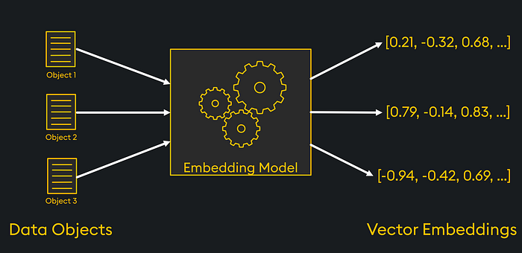
What is a vector embedding?
A vector embedding, or simply "embedding," is a way to turn things that aren't numbers (like words or pictures) into a list of numbers. This list captures the important qualities and relationships within the original data. Embeddings are really helpful for machine learning tasks.

Slide 22
How embeddings make sense of data?
Embeddings try to "understand" the meaning, context, or structure of the information they represent. This helps with specific tasks. Different types of data (like audio, text, video, etc.) need different embedding methods or algorithms to do this well.
[0.07, 0.76, -0.87, 0.34, 0.22, …]
Audio Vector Embeddings
Audio
Audio Model
[0.79, -0.32, -0.14, 0.92, 0.31, …]
Text Vector Embeddings
Text
Text Model
[-0.94, 0.63, -0.27, 0.46, 0.12, …]
Video Vector Embeddings
Video
Video Model

Slide 23
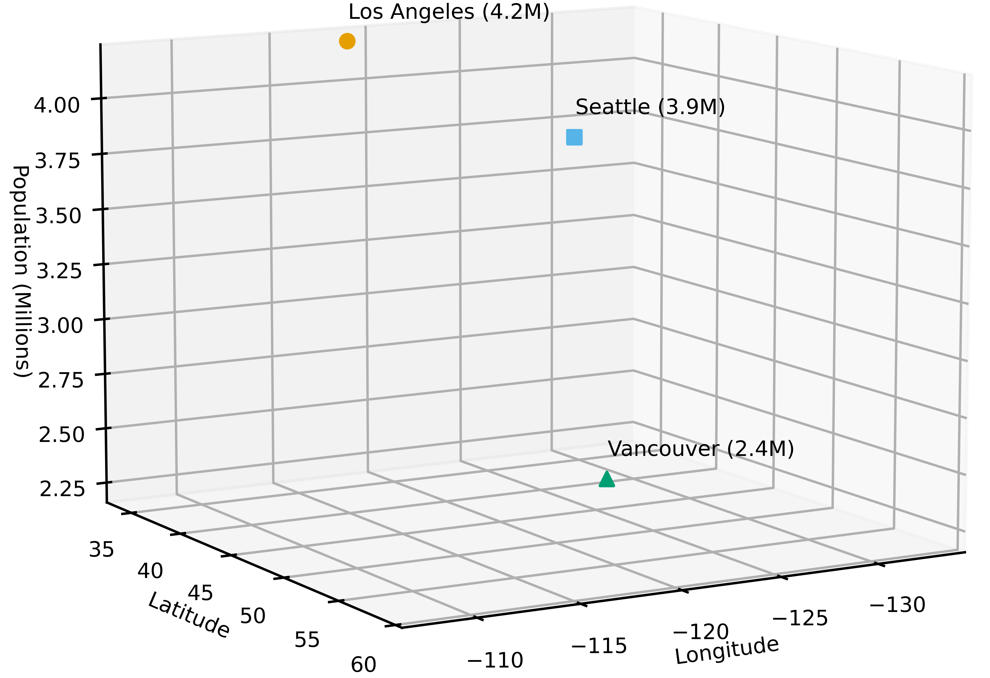
What is a vector embedding?
A vector is a fixed-length array of numbers that represents a point in a mathematical space.
Each number in the array corresponds to a direction (or dimension) within this space, and its value determines the vector's magnitude in that direction.
While vectors in machine learning can have thousands of dimensions (difficult to visualize), simpler vectors with two or three dimensions can be easily graphed and understood.
A vector embedding, or simply "embedding," is a way to turn things that aren't numbers (like words or pictures) into a list of numbers. This list captures the important qualities and relationships within the original data.
Different types of data (like audio, text, video, etc.) need different embedding methods or algorithms to do this well.
City | Longitude | Latitude | Population (Millions)
San Francisco | -122.4 | 37.8 | 4.2
Seattle | -122.3 | 47.6 | 3.9
Vancouver | -123.1 | 49.3 | 2.4

Slide 24
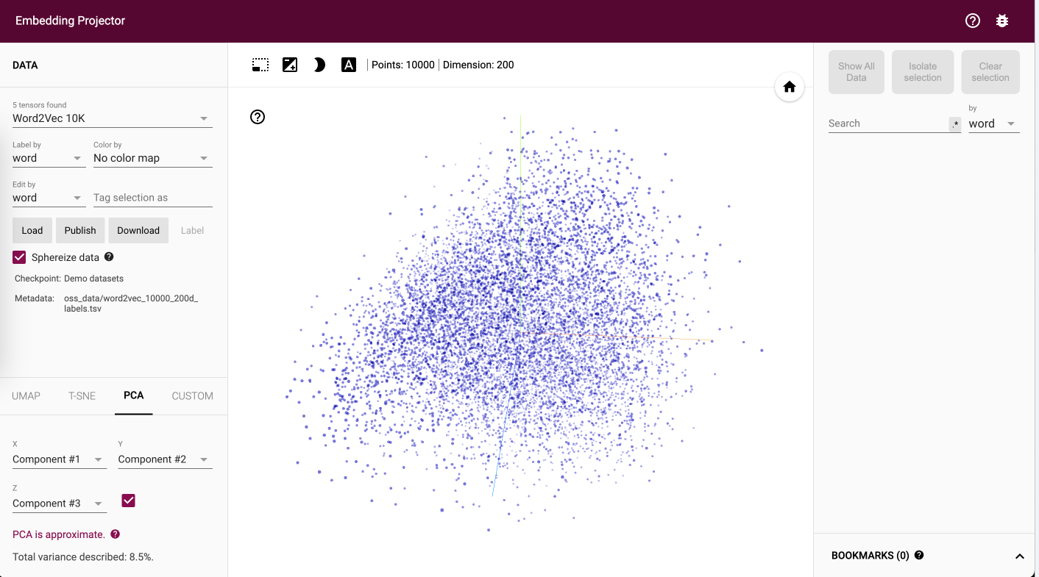
Pre-trained Embedding Model
Tools like https://projector.tensorflow.org/ can help visualize
Which of these words is most likely to be close in 'meaning space' to the word 'innovation’?
Improvements
Inventions
Modifications
Innovation
Innovative

Slide 25
Business Benefits
Smarter Search, Deeper Insights: Find documents, products, or information based on true meaning, not just keyword matches.
Enhanced Customer Understanding: Analyze feedback, reviews, and social media sentiment with nuance for actionable insights.
Streamlined Processes: Automate tasks that rely on understanding language – from support ticket routing to content summarization.
Competitive Edge: Extract valuable information and patterns from text data that traditional methods miss.

Slide 26
Questions to Stimulate Discussion
Challenges: "What are some current tasks where our ability to understand language is a bottleneck?" This surfaces pain points embeddings might address.
Data: "What kinds of text data do we have that might be underutilized (e.g., customer support, market search, compliance, etc.)?"
Feasibility: "Are there areas where a small-scale embedding project could be a good proof-of-concept?" This promotes actionable next steps.

